Slide 1
Summer Paris Olymics-2024 A Power BI report by Athira Mohan

Slide 2
ABOUT
DATASET OVERVIEW 3
RELATIONSHIP 8
POWER BI REPORT 12
INSIGHTS,RECOMMENDATIONS 14
CONCLUSIONS 15

Slide 3
PARIS OLYMPICS-2024
The 2024 Summer Olympics, officially known as the Games of the 33rd Olympiad with a motto “Where the world beats”, were held in Paris, France from July 26 to August 11, 2024. The games featured 329 events across 32 sports, with athletes count 11113 from 206 different countries competing. The opening ceremony was held on the Seine, and the closing ceremony took place at the Stade de France.

Slide 4
About the Dataset
This dataset provides a comprehensive overview of the Paris 2024 Olympic Summer Games, including key information about events, sports, athletes ,medals achieved and participating countries.
It aims to facilitate analysis and insights related to the upcoming Olympics, highlighting various aspects such as athlete participation, historical data, event scheduling and how countries are progressed in sports over the years.
Researchers, sports enthusiasts, and data analysts can leverage this dataset to explore trends, make comparisons, and gain a deeper understanding of the Games.

Slide 5
About the Dataset-Tables Overview
This dataset contains mainly 5 tables with the details of Athletes , Medallist , MedalsTotal ,Teams and Historical Data.
Athletes table contains information on participating athletes, including their profiles and nationalities

Slide 6
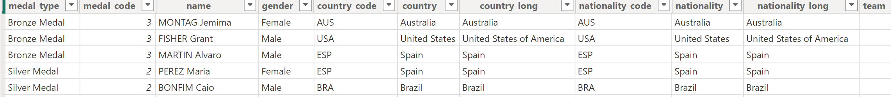
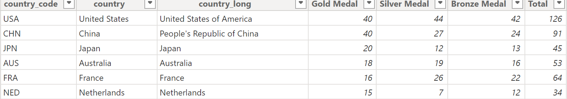
About the Dataset- Tables Overview
Medalist table details the medal winners for various events, showcasing outstanding performances along with the nationalities.
Medals Total provides a summary of the total medals won by each participating country, highlighting competitive standings.

Slide 7
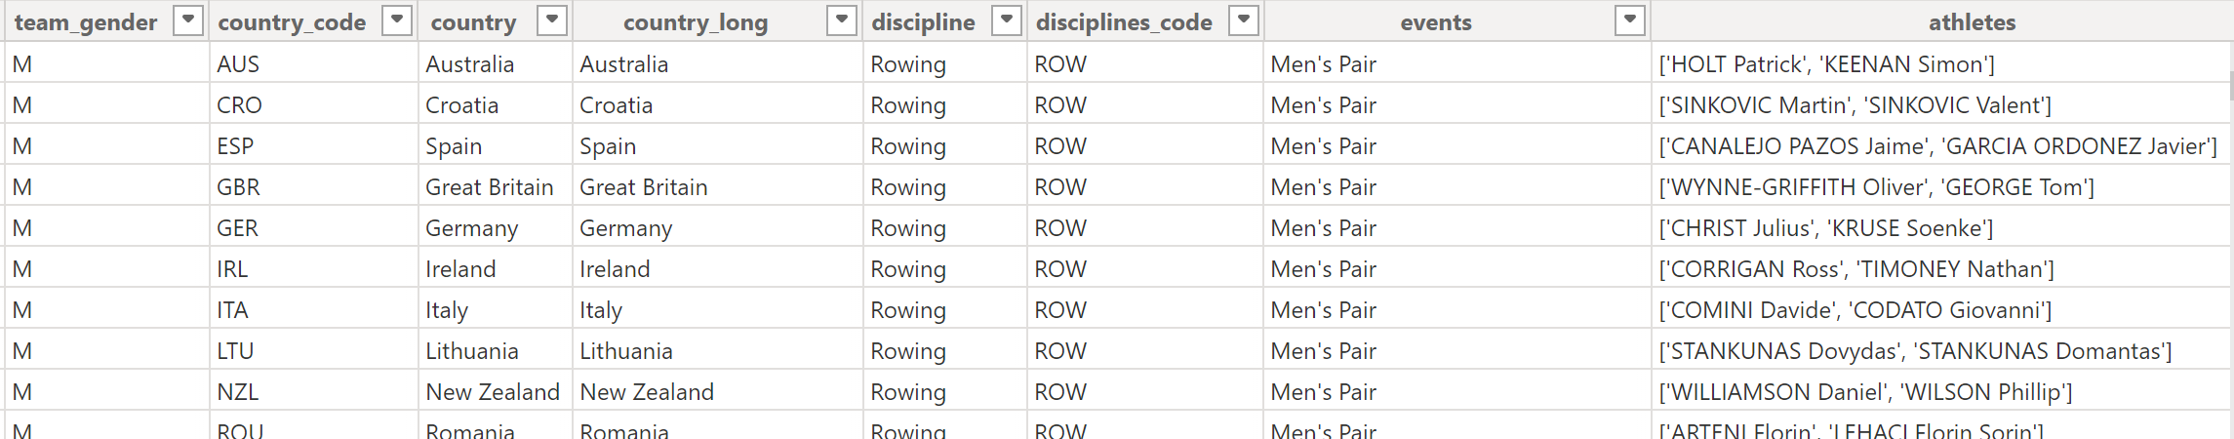
About the Dataset- Tables Overview
Teams table lists the national teams competing in the Games, including their respective sports.
Historic Data contains historical information about previous Olympic Games, allowing for trend analysis and comparisons.

Slide 8
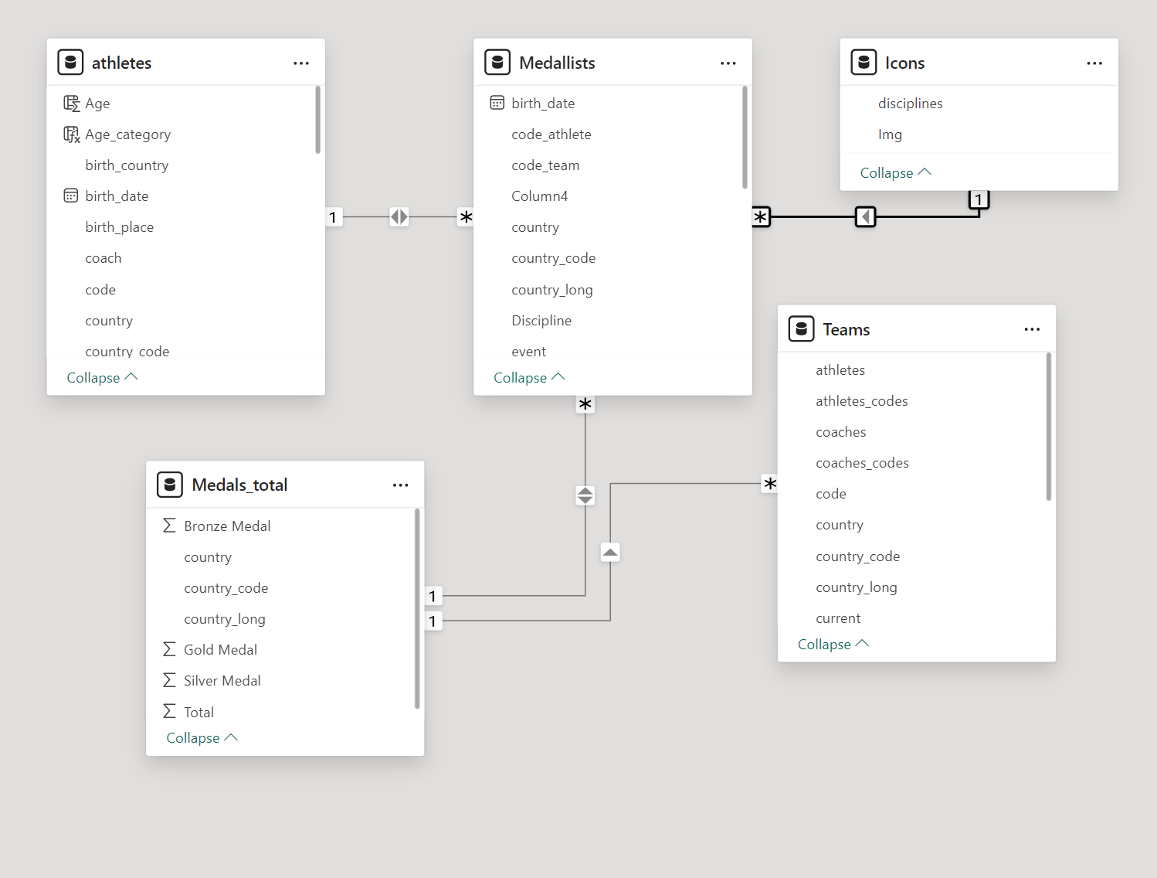
Relationships & Data Flow
Data modeling for your dataset involves designing how the data will be structured, organized, and related.

Slide 9
Relationships & Data Flow
Medalists table considered as central tables (fact tables), as they hold measurable data related to medals and performance.
Other tables like Athletes, Teams, and Countries with Flags URL act as dimension tables, providing descriptive information about athletes, teams, and countries, respectively.

Slide 10
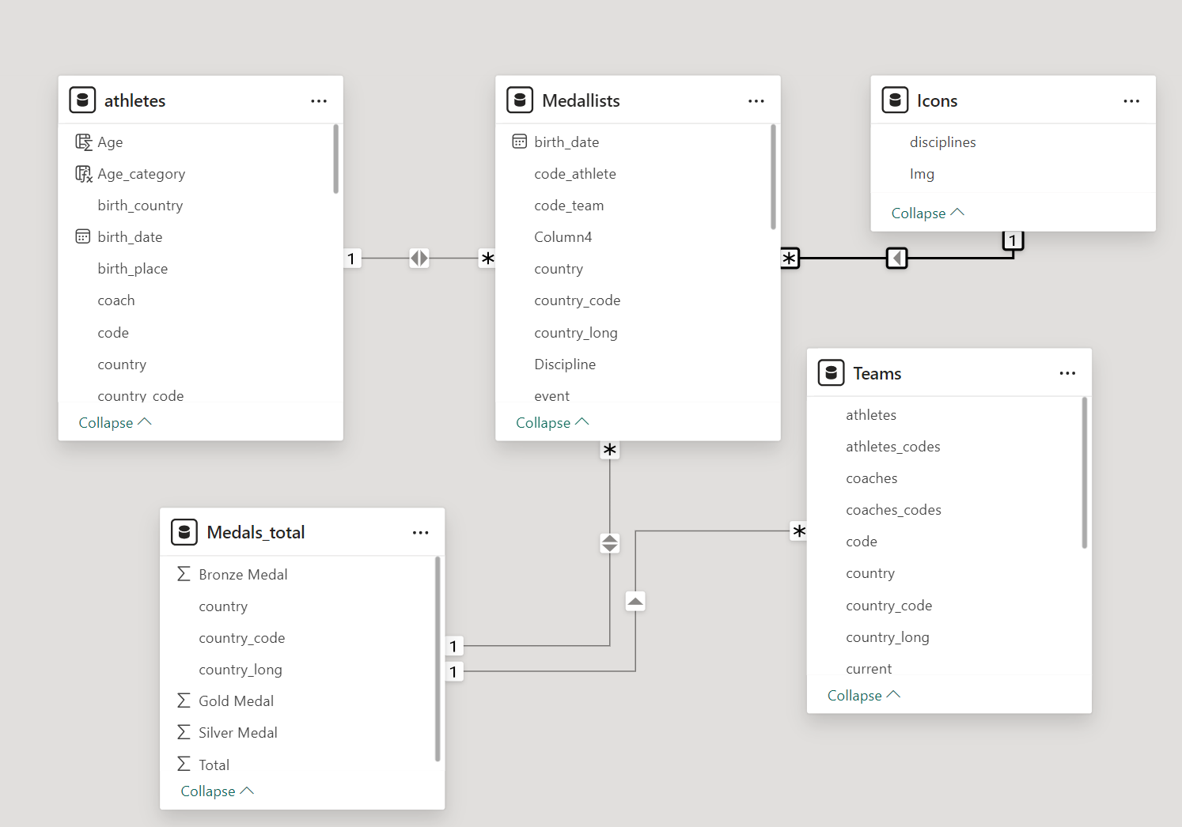
Relationships & Data Flow
Athletes → Medallist shares (1:*) cardinality in bi-direction.
Medals Total → Medallist shares (1:*) cardinality in bi-direction.
Medals Total→ Teams shares (1:*) cardinality in single direction.
Icons→ Medallist shares (1:*) cardinality in single direction.

Slide 11
DAX Functions
In this analysis, the DAX functions used:
Aggregate Function: SUM , DISTINCTCOUNT , MAX
Filter Function: CALCULATE
Logical Function: IF
Information Function: ISBLANK
Table Manipulation Function: VALUES
Date & Time Function: DATEDIFF

Slide 12
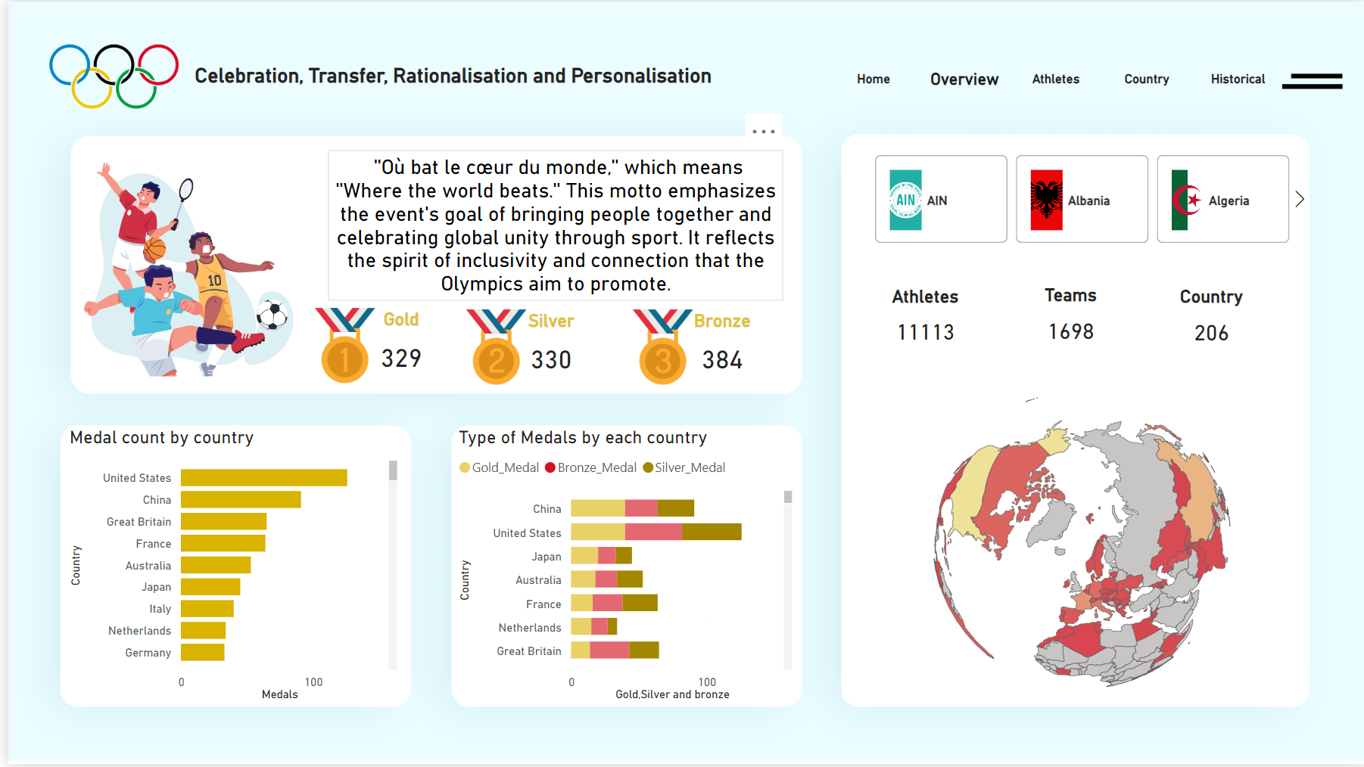
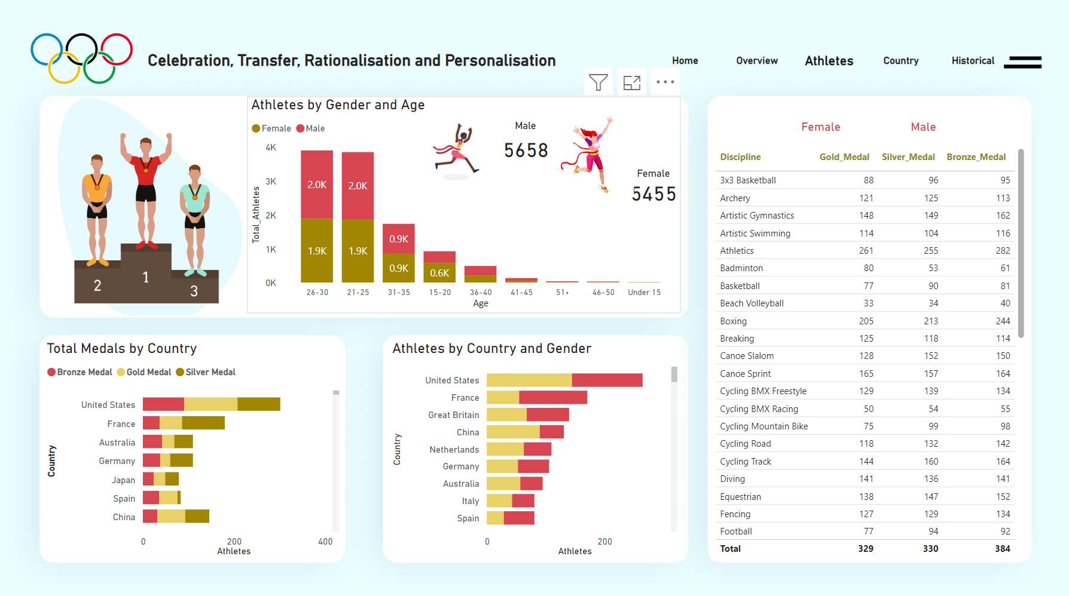
REPORT PAGES

Slide 13
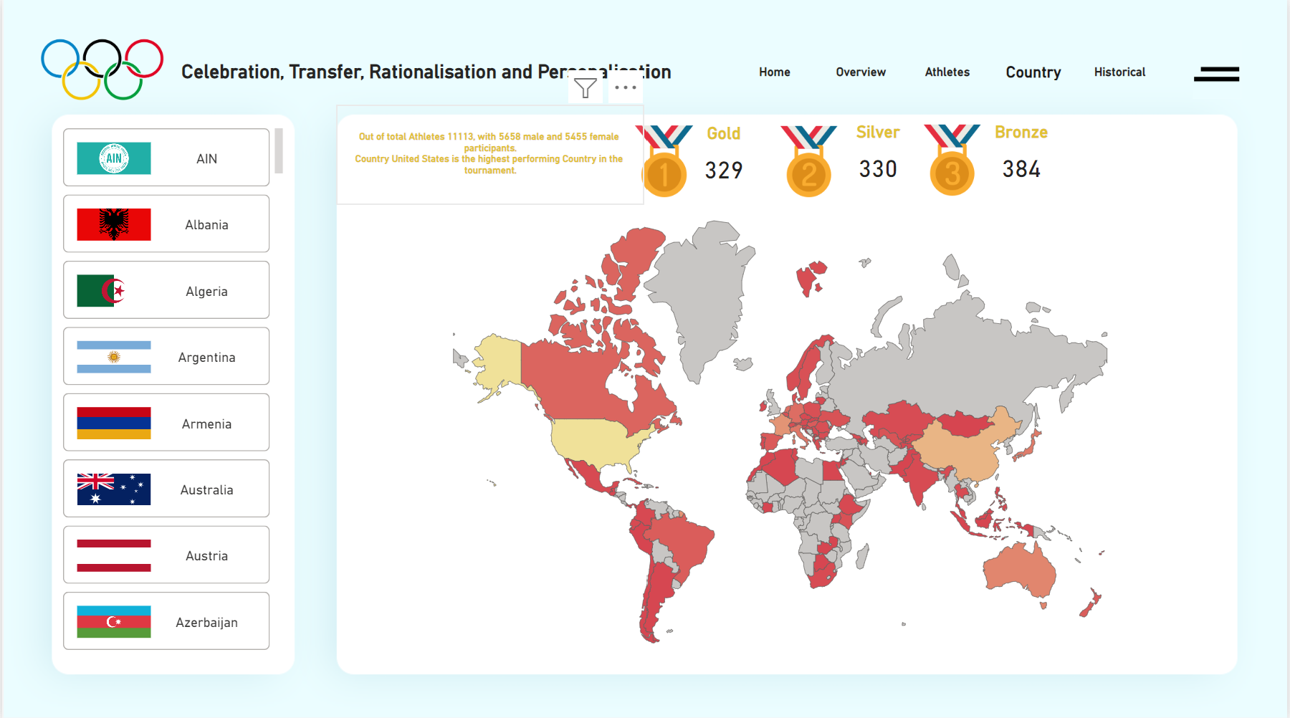
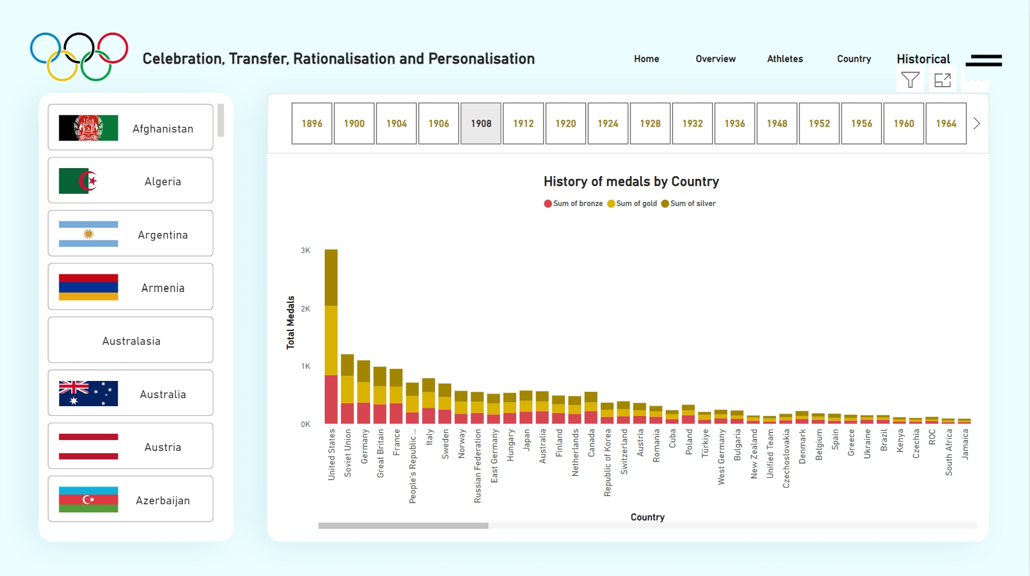
REPORT PAGES

Slide 14
INSIGHTS RECOMMENDATIONS
Medal Distribution by Country
Performance Trends Over Time
Athlete Contributions
Team Performance Insights
Targeted Training Programs
Athlete Development
Increased Funding for Sports
Data-Driven Strategy

Slide 15
These insights and recommendations can guide discussions on improving performance in future Olympic Games, focusing on data-driven strategies and investment in athlete development CONCLUSION

Slide 16
thank you – Athira☺

